Slide 1
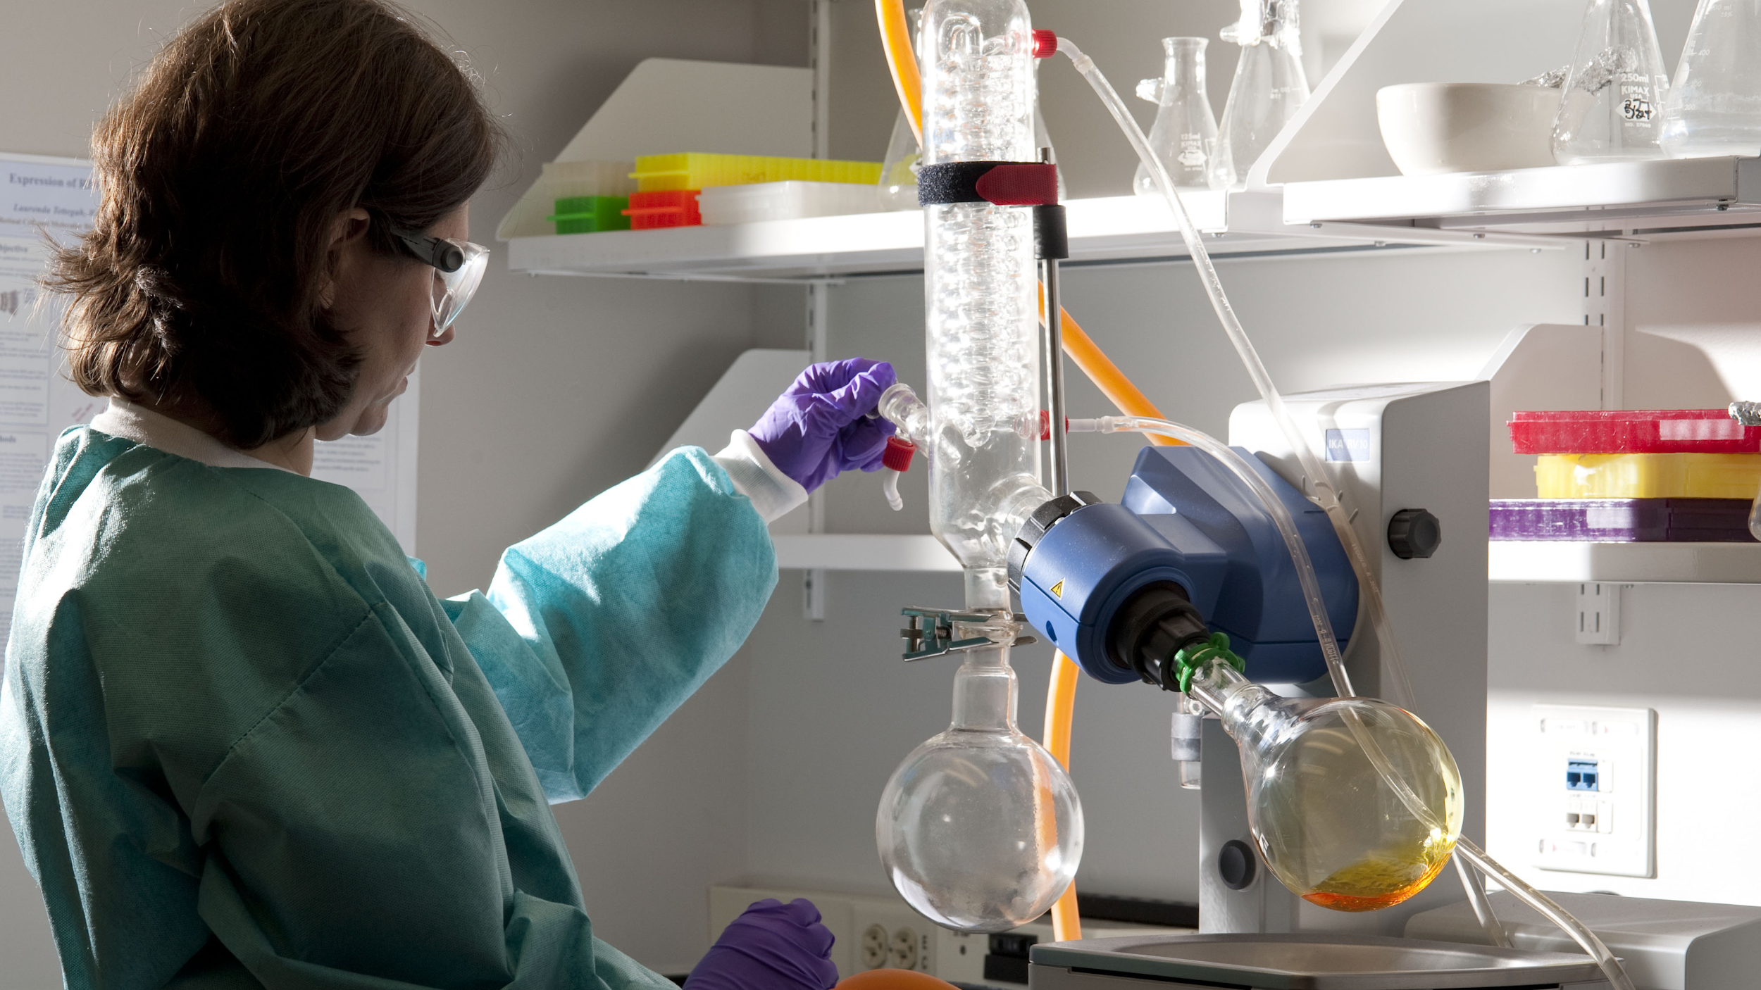
LABORATORY SAFETY
We will summarise the safety rules within a laboratory

Slide 2
Do not delete this slide.
This slide is designed so that you can copy the prompt box you need and insert it into your slides.
This slide is hidden and will not be included when presenting your lesson.
TRACK WITH ME
VOCABULARY
1 -
HINT
Students, remember….
CHECK FOR UNDERSTANDING
READ WITH ME
TEACHER CUE
MAKE THE CONNECTION
Students, you already know….
EXTENSION

Slide 3
1) List potential hazards you could find in a laboratory.
2) Create three rules that would help reduce those hazards.

Slide 4
Repeat the opposite word/phrase.
DEMONSTRATE
SHOW WITH ACTION

Slide 5
Repeat the opposite word/phrase.
GESTURE
TO SHOW WITH ACTION

Slide 6
Repeat the opposite word/phrase.
LABORATORY
ROOM FOR SCIENCE

Slide 7
Repeat the opposite word/phrase.
TRACK WITH ME
READ SILENTLY

Slide 8
Repeat the opposite word/phrase.
READ WITH ME
READ ALOUD

Slide 9
We will explore safety in the laboratory
TRACK WITH ME
READ WITH ME
We will define laboratory
We will list safety rules for the laboratory
DECLARE THE OBJECTIVE
Read the learning objective to your partner.
Notes:
Learning Objectives contain concepts (nouns, big ideas), skills (verbs, measurable behaviours) and sometimes context (restricting or targeting conditions).
●Example: Students will be able to describe the concept of density and apply it to floating and sinking.
●
Success criteria are specific measurable outcomes that if met mean that the student has met the learning objective.
Examples:
•Students will be able to compare densities of substances using mass and volume.
•Students will be able to identify whether a solid or liquid will float or sink in a liquid based on their densities.

Slide 10
We will explore safety in the laboratory
Safety rules are rules to stop people from being hurt or injured.
What are some safety rules that you know?
Pair-Share
TRACK WITH ME
MAKE THE CONNECTION
Students, you already know some examples of common safety rules: Never go anywhere with a stranger Look both ways before you cross the road Do not share personal information online

Slide 11
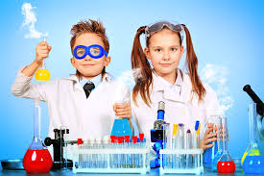
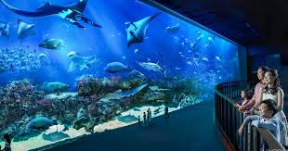
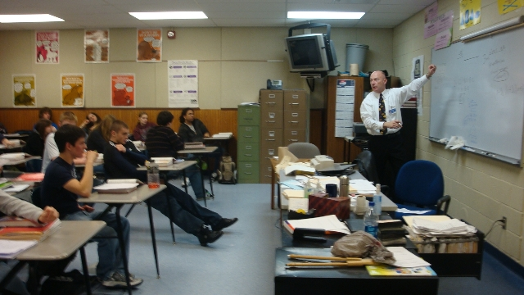
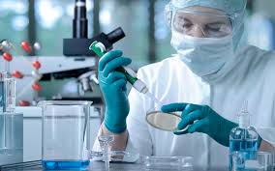
We will summarise the safety rules within a laboratory
A laboratory₁ is a room prepared for scientific₂ experiments, research or teaching.
TRACK WITH ME
READ WITH ME
A
B
CHECK FOR UNDERSTANDING
What is a laboratory? Which of these pictures show laboratories?
C
D
VOCABULARY
1 - a room for scientific experiments, research or teaching 2 - to do with science

Slide 12

We will explore safety in the laboratory
We must know the safety rules within a laboratory₁ so that everyone remains safe.
It’s important that the rules are followed and that you are able to summarise the safety rules.
CHECK FOR UNDERSTANDING
What is one safety rule for the laboratory? Pair-Share
VOCABULARY
1 - a room for scientific experiments, research or teaching.

Slide 13
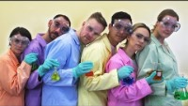
We will explore safety in the laboratory

Slide 14
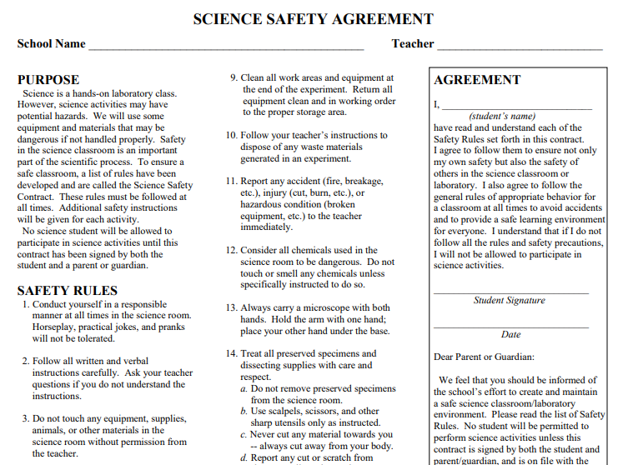
We will explore safety in the laboratory
READ WITH ME
To make sure we are all safe in this laboratory we are going to sign a Safety Contract that covers all the safety rules.
TEACHER CUE
This will need to be sign by both student and parent before student can participate in experiments.

Slide 15
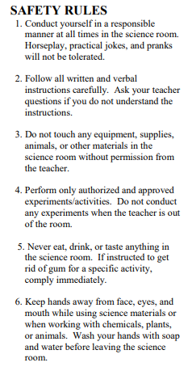
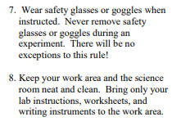
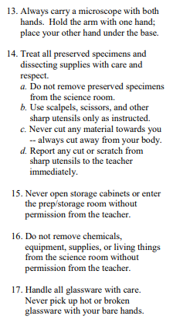
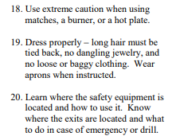
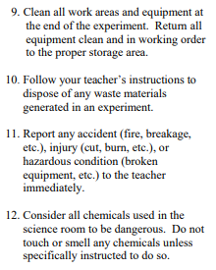
We will explore safety in the laboratory
READ WITH ME

Slide 16

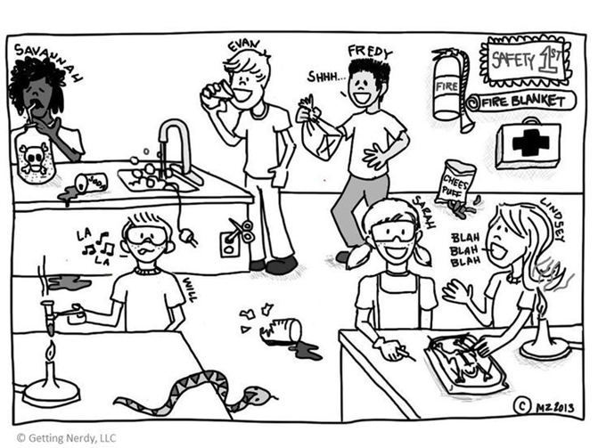
5 minutes
We will explore safety in the laboratory
Write down the rules being broken in the picture below.
In your notebooks, summarise₁ the safety rules within a laboratory₂.
CHECK FOR UNDERSTANDING
What does summarise mean? Pair-Share
HINT
Students, remember that safety rules stop people from being hurt or injured.
VOCABULARY
1 - write the main ideas 2 - a room for scientific experiments, research or teaching

Slide 17
We will summarise₁ the safety rules within a laboratory
We will define laboratory
We will list safety rules for the laboratory
VOCABULARY
1 - write the main ideas
CHECK FOR UNDERSTANDING
Check Success Criteria.
Notes:
Learning Objectives contain concepts (nouns, big ideas), skills (verbs, measurable behaviours) and sometimes context (restricting or targeting conditions).
●Example: Students will be able to describe the concept of density and apply it to floating and sinking.
●
Success criteria are specific measurable outcomes that if met mean that the student has met the learning objective.
Examples:
•Students will be able to compare densities of substances using mass and volume.
•Students will be able to identify whether a solid or liquid will float or sink in a liquid based on their densities.

Slide 18
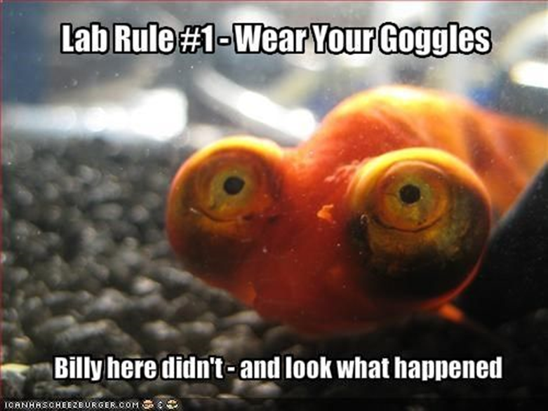
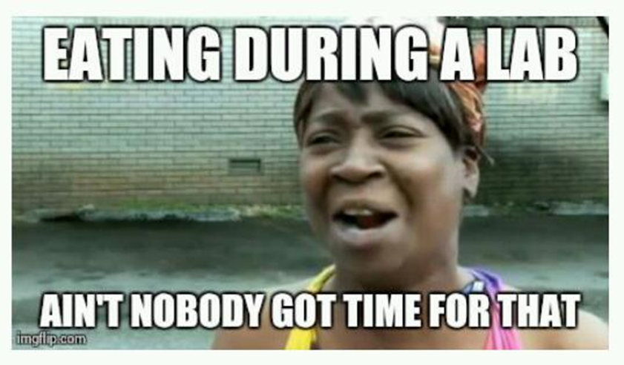
We will explore safety in the laboratory
You will be allocated a safety rule to make a poster or meme about.
CHECK FOR UNDERSTANDING
Which safety rule are you going to create a poster for? Pair-Share
Use the examples below as inspiration.
HINT
Students, remember that safety rules stop people from being hurt or injured.
VOCABULARY
1 - a room for scientific experiments, research or teaching
Notes:
Please include tasks/questions here rather than just referring to a worksheet. This will save on photocopying and facilitate sharing with other schools.
Try and build tasks/questions which escalate through Bloom’s Taxonomy. This will help with differentiation.

